Slide 1



Power BI Desktop
Olympics 2024 Paris
Dashboard by Sabarinath
Home Overview Athletes Country
Historical

Slide 2









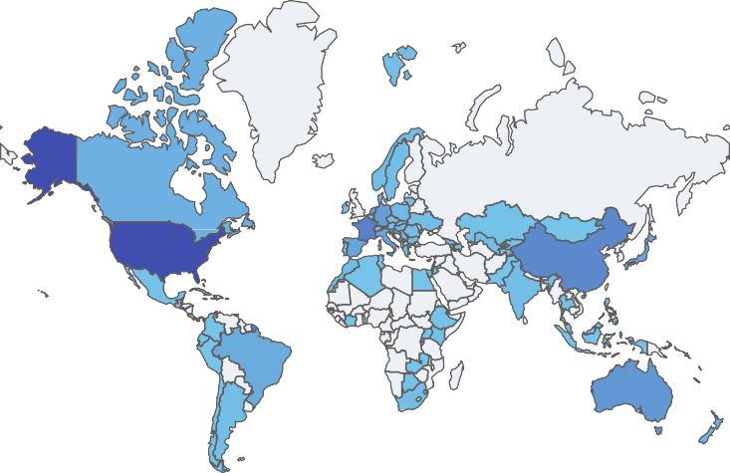
Power BI Desktop
Home
Overview
Athletes
Country
Historical
Olympic Highlights
country
Total athletes :11113,with 5658 male and 5455 female
participants. The male won 374, and the female won 378 in the tournament. Country USA is the highest-performing…
AIN
Albania
Algeria 
Silver
760
Bronze
813
206
Country
1698
Teams
11113
Total_Athletes
Gold
752
Medals by country and medal_type
medal_type Bronze M… Gold Me… Silver Me…
United Sta…
France China Great Brit… Australia Netherlan…
Medals by country and gender
gender Female Male
United Sta…
France China Great Brit… Australia Netherlan…
0
200 400
Medals
0
200
Medals
400

Slide 3


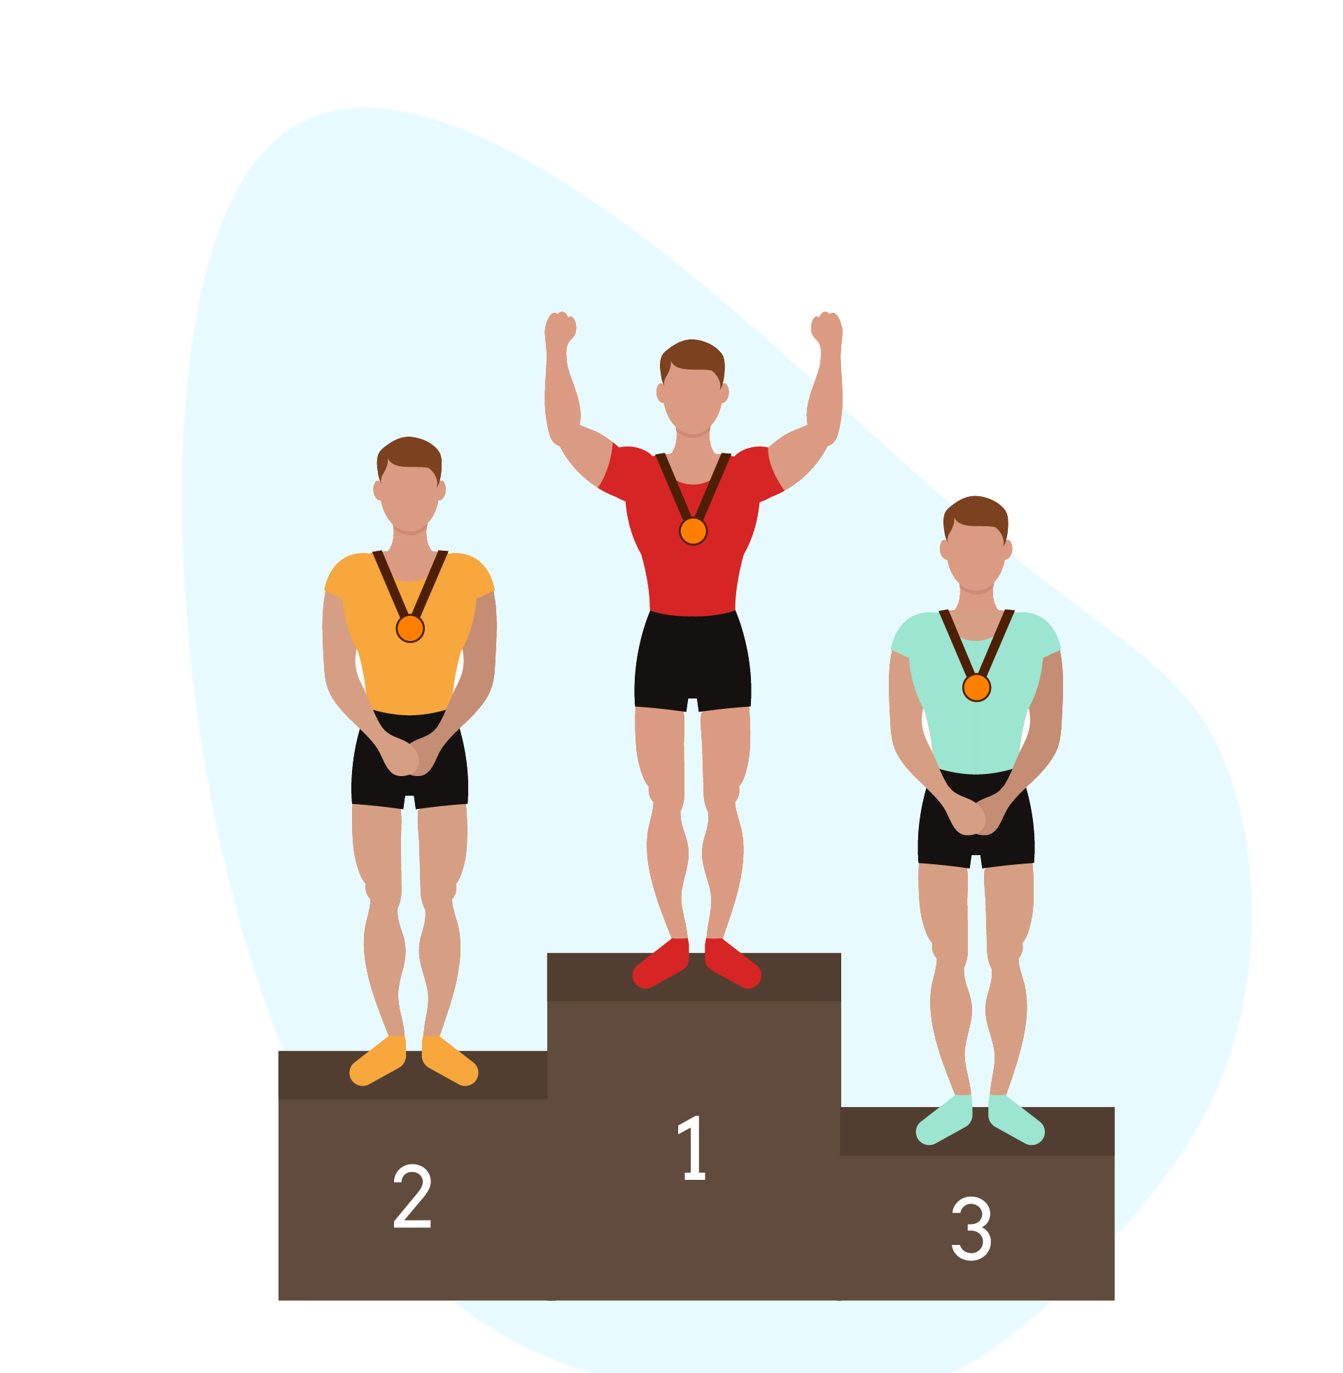


Power BI Desktop
Home
Overview
Athletes
Country
Historical
Athletes
by Age Category and gender
gender Female Male 4K
Search
5658
Male
5455
Female
Gold
Total 752 where Male got
374 Gold Medals and Female got 378 Medals.
Total_Athletes
752
2K
0K
26-30 21-25 31-35 15-20 36-40 41-45 51+ 46-50 Under
15
Silver
Total 760 where Male got 375 Silver Medals and Female got 385 Medals.
760
Total_Athletes by country and medal_type
medal_type Bronze M… Gold Me… Silver Me…
United Sta…
France Australia Germany
Japan
Total_Athletes by country and gender
gender Female Male
United Sta…
France Australia Germany
Japan Spain
0K 1K
Total_Athletes
Bronze
813 Total 813 where Male got
409 Bronze Medals and…
0K
1K 2K
Total_Athletes

Slide 4


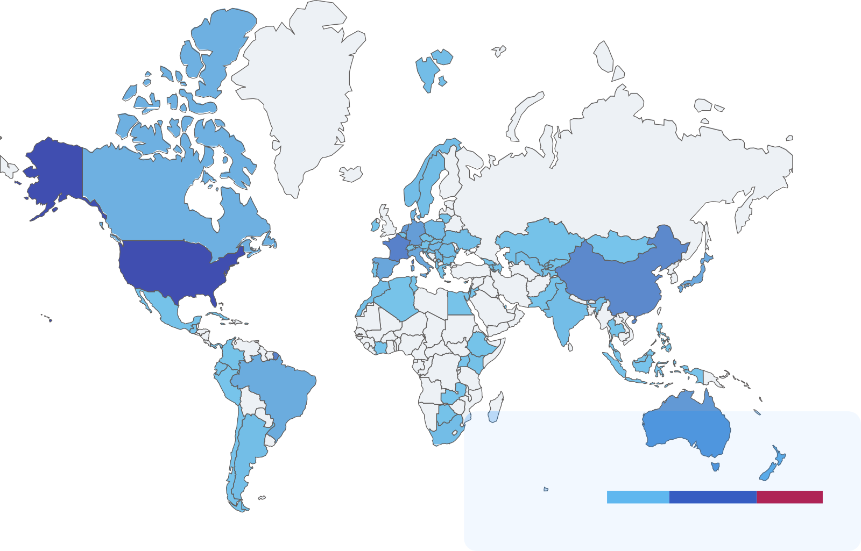








Power BI Desktop
Home
Overview
Athletes
Country
Historical
Gold
752
Silver
760
Bronze
813
Search
Country overview
country
AIN
Albania Algeria Argentina
>
Armenia
Australia
Olympic Highlights
Top performer Country
Austria
Total athletes :11113,with 5658 male and 5455 female
participants. The male won 374, and the female won 378 in the tournament. Country USA is the highest-performing…
Azerbaijan
United States

Slide 5


Power BI Desktop
Home
Overview
Athletes
Country
Historical
Search
year
1896
1900
1904
1906
1908
1912
1920
1924
1928
1932
>
country
AIN
Gold, Silver and Bronze by year
Gold Silver Bronze
Albania
1000
Algeria
800
Argentina
>
600
Armenia
Australia
400
Austria
200
Azerbaijan
0
1900
1950
2000

